Slide 1
Flat Field Illumination on AutoCyPlex

Slide 2
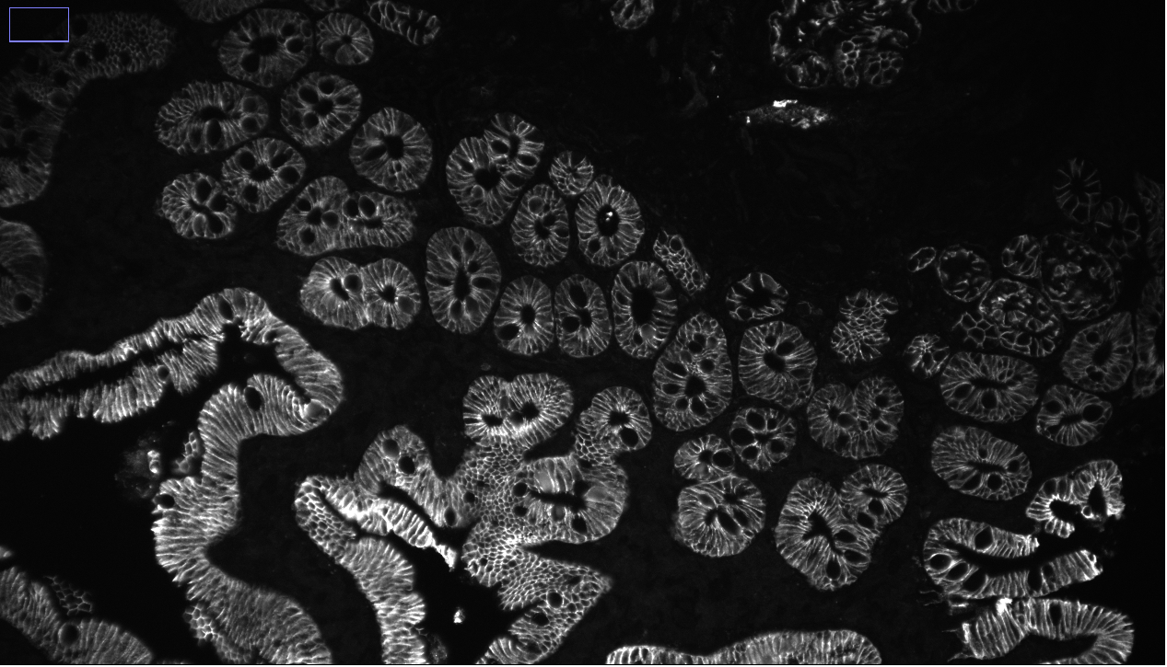
Background
Noticed significant uneven illumination in images, especially in corners.
Very Dim
Good brightness

Slide 3
Current Setup
We are trying to drive the FOV up as high as possible. To do this we combined a very high Field Number objective in a Nikon series 175 16x water dipping objective with a small pixel (4.25um) high sensor size camera size in the photometrics IRIS 15 (2960x5056). We did an additional magnification via a 260mm tube instead of 200 which is a mag factor of 1.3. This was to eliminate projected vignetting.
We use an ASI LED tree system.
Jon Daniels from ASI did vignetting calculations and we can have 155mm of space below the optical pinch point right above the dichroic C60 cube. We currently use 135mm of space.

Slide 4
Potential solutions
Increase overlap and crop off image portions that have poor illumination
Swap to 100mm tube over 160mm tube. This magnifies the illumination profile by a factor of 1.6x.
Swap to a 3mm liquid light guide and light engine illumination system.

Slide 5
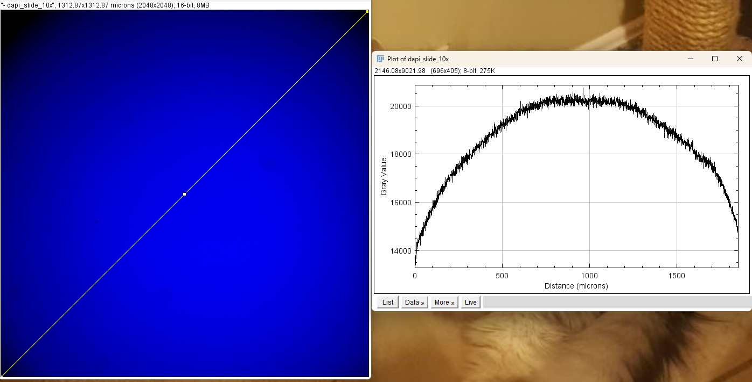
What is good enough flat field illumination?
Its hard to find standards for this thing. Iain from Lumencor said 20% roll off is acceptable, but didn’t seem confident in it.
Doubtful industry standard exists
Given standards don’t seem to exist, what does the illumination profile look like on a professionally installed and engineered microscope that has recently been installed, look like?
DAPI slide on Leica Thunder widefield system with lumencor light engine and 3mm LLG
Camera is 2048x2048 (6.5um pixels) and objective was 10x

Slide 6
Testing Methods
AutoCyPlex
On the autocyplex, I focused on a piece of tissue in the DAPI channel on the slide.
Lifted the objective up
Swap slide with chroma test slide which are plastic slides uniformly doped with certain fluorophores.
All illumination sources and tubes were swapped and bothing tinkered with from dichroic to focus position.
Leica
Didn’t change pattern significantly with focus shifting and nothing to really focus on so I merely chose a position
Took DAPI and A488 slide images with various objectives to gauge how the pattern changed. No focus change done.

Slide 7
Analysis Metrics
Hard to quantify all of what being flat field encapsulates into one metric, especially for rectangular chips like I have. Here are some decided on for this analysis.
Make super pixels in image (24x32, same as what I break images into for autofocus)
Rolloff = max_super_pixel – lowest_corner_super_pixel
R10, R25, R50, R75 = radius from center where int = 10,25,50,75% of max respectively
Max image radius (for comparison with R10, …)
Center line X,Y rolloff = using orthogonal cross lines find max_inline minus min_inline in Y and X

Slide 8
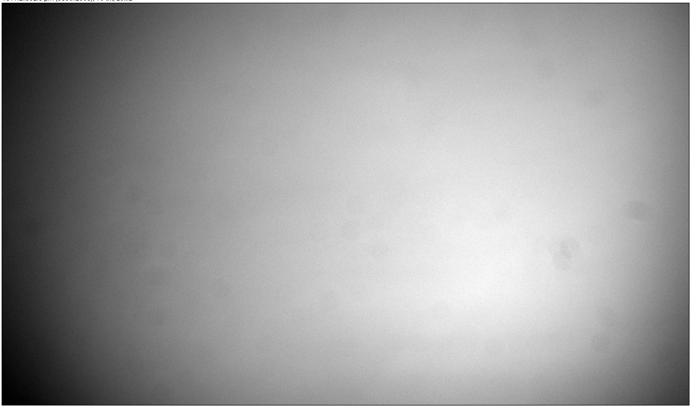
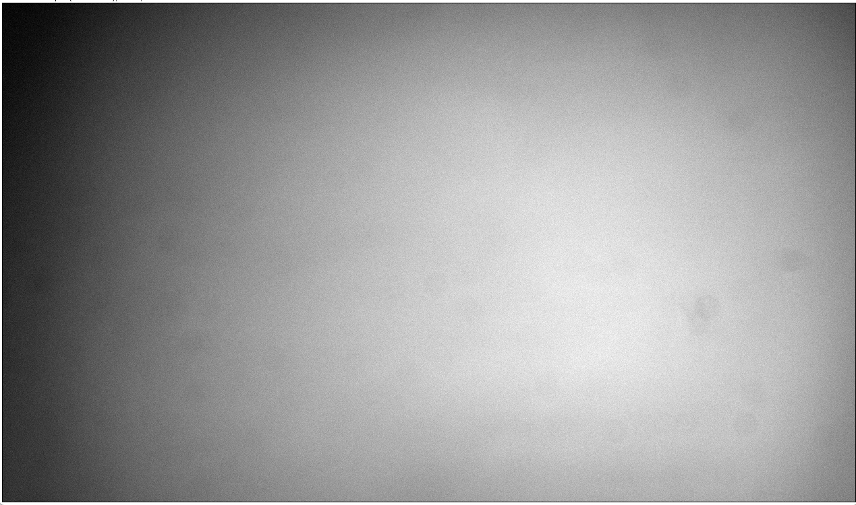


ASI LED System
160mm Tube
100mm Tube
Lumencor LLG System

Slide 9

Backing out the LLG
LLG fully inserted
LLG backed out 5mm

Slide 10
Results
Note 2929 is max radius for image from autocyplex, 1488 is max for the leica thunder
Hitting max radius at R75 means the corner to max signal ratio never drops below 0.25 in the entire image.
image | max roll off | r10 | r25 | r50 | r75 | y line roll off | x line roll off
llg pulled back short tube | 0.29 | 732 | 1220 | 2197 | 2929 | 0.8 | 0.48
llg short tube | 0.17 | 488 | 976 | 1708 | 2197 | 0.63 | 0.3
llg long tube | 0.14 | 488 | 1220 | 1708 | 2197 | 0.67 | 0.27
asi long tube | 0.48 | 732 | 1708 | 2929 | 2929 | 0.87 | 0.59
asi short tube | 0.58 | 732 | 2929 | 2929 | 2929 | 0.84 | 0.65
leica 488 10x | 0.58 | 603 | 1488 | 1488 | 1488 | 0.8 | 0.82
leica 488 20x | 0.63 | 482 | 965 | 1488 | 1488 | 0.8 | 0.81
leica 488 40x | 0.63 | 603 | 1488 | 1488 | 1488 | 0.81 | 0.83
leica dapi 5x | 0.71 | 1488 | 1488 | 1488 | 1488 | 0.85 | 0.86
leica dapi 10x | 0.62 | 603 | 1488 | 1488 | 1488 | 0.84 | 0.86
leica dapi 20x | 0.65 | 603 | 1086 | 1488 | 1488 | 0.82 | 0.83

Slide 11

Image side vignetting?
Successful illumination of corner
To test if the corners are darkened due to vignetting, I tilted the dichroic to move the mean center towards the corner. If its vignetted, I should not be able to illuminate it very well. If it isn’t, it will illuminate well.

Slide 12
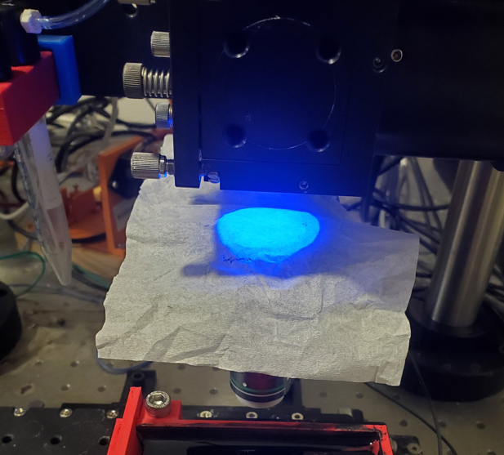
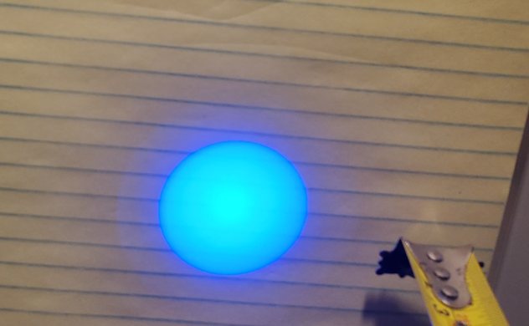
How did illumination look by eye?
Illumination at approx. distance from tube to back focal plane of objective
Illumination entering back of objective when in focus position

Slide 13
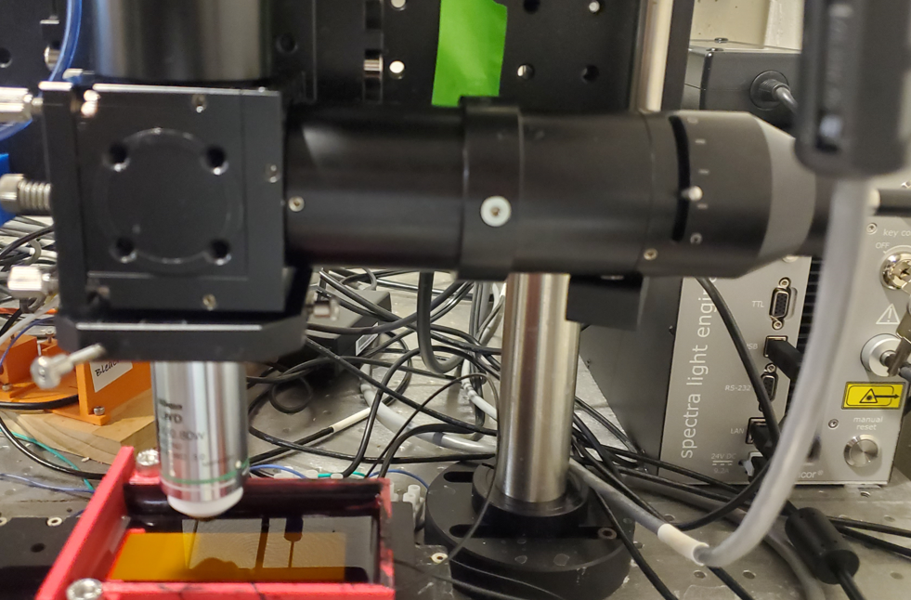
Microscope Setup
100 illumination tube
C60-camera spacer
LLG coupler
Note, images taken with fully open field aperture

